Slide 1

Multi-Target Reinforcement Learning for Warehouse Path Optimization
Ayham Hanna
Email: haay20ju@student.ju.se

Slide 2
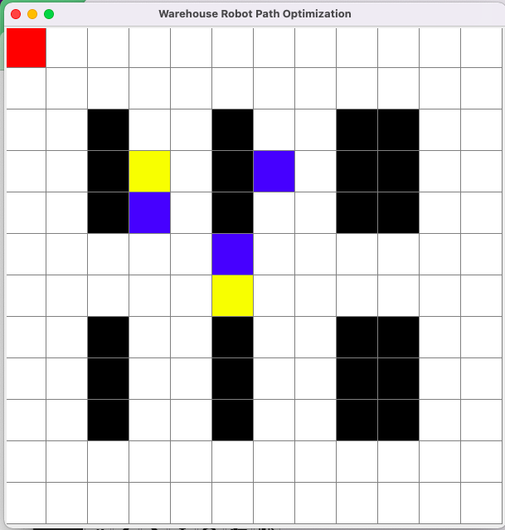
Problem
12x12 grid
Empty space (0)
Obstacle (1)
Item (2)
Human (3)
Up (0): (−1,0)
Down (1): (1,0)
Left (2): (0,−1)
Right (3): (0,1)
Wait (4): (0,0)

Slide 3
Reward System
+200: collecting an item
+500: collecting all items
+700: returning to the start position
-500: colliding with a human
-200: hitting an obstacle
-300: moving Out of bounds
-1: step penalty for unnecessary movements

Slide 4
Methodology
Q-Learning Learning Algorithm
Separate Q-Tables for Each Target
Exploration vs. Exploitation
Exploration probability (ϵ)
Decay factor
Minimum exploration threshold (ϵmin)

Slide 5
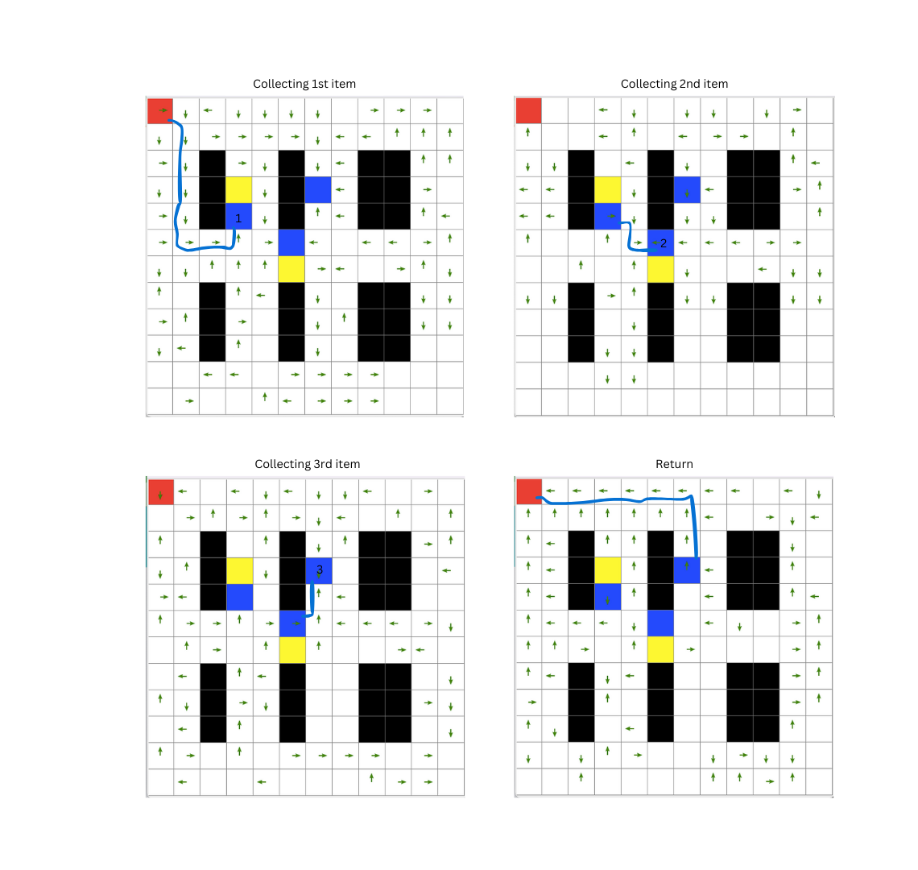
Evaluation
Visualization for understanding and debugging
Policy Visualization
Average reward
Training time

Slide 6

Experiments
Experiments with static humans
Easy targets distribution
Harder targets distribution
Experiments with dynamic humans
Experiments for hyperparameters tuning
Optuna
learning rate: (0.01, 0.5)
discount factor: (0.5, 0.99)
exploration rate: (0.9, 0.9999)

Slide 7






Experiments
Experiments with static humans
Easy targets distribution
Harder targets distribution
Experiments with dynamic humans
Experiments for hyperparameters tuning
Optuna
learning rate: (0.01, 0.5)
discount factor: (0.5, 0.99)
epsilon decay factor: (0.9, 0.9999)

Slide 8
Results and Analysis
 | 1000 episodes | 2000 episodes | 4000 episodes
150 steps | -143 | 3 | 129
300 steps | -135 | 31 | 175
 | 1000 episodes | 2000 episodes | 4000 episodes
150 steps | -228 | -199 | -114
300 steps | -225 | -202 | -82

Slide 9
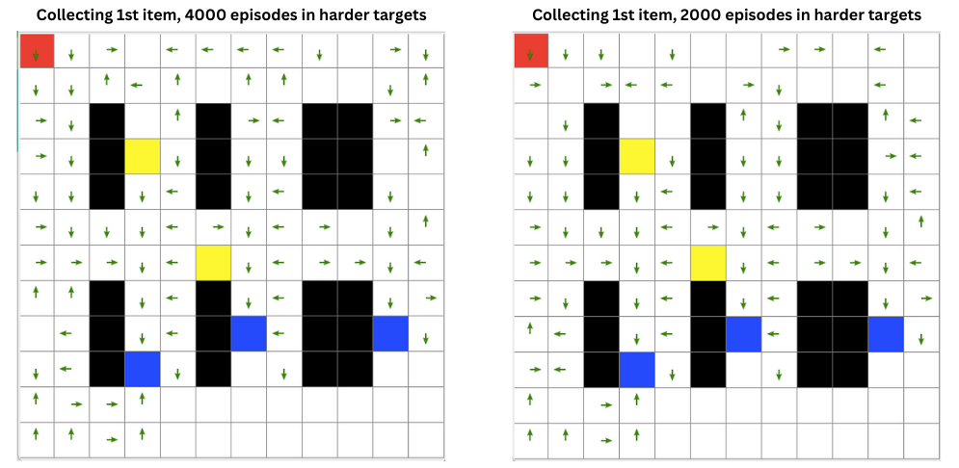
Results and Analysis
 | 1000 episodes | 2000 episodes | 4000 episodes
150 steps | -228 | -199 | -114
300 steps | -225 | -202 | -82
 | 1000 episodes | 2000 episodes | 4000 episodes
150 steps | 666 | 1288 | 2025
300 steps | 668 | 1233 | 2151

Slide 10
Hyperparameters tuning
learning rate: 0.42
discount factor: 0.86
epsilon decay factor: 0.978
average reward, increasing it from -82 to 160
average training time of 844 milliseconds
average collected reward per run of 118.5.

Slide 11
Demo time

